Slide 1
Architecture
Python Web Server
End User
Accu Weather API
Return Location Code for City Name
Return Weather for the Location Code

Slide 2
Step 1
Startup program to just check fast API execution

Slide 3
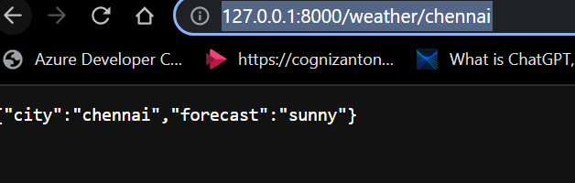
Step 2
# create a fast api function that returns a weather forecast for a city
Response:
CP responded with that I should frame my function then it starts giving the actual code partially.

Slide 4
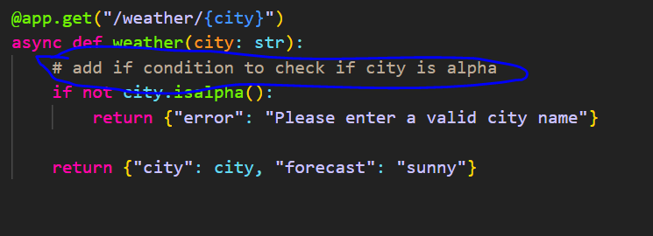
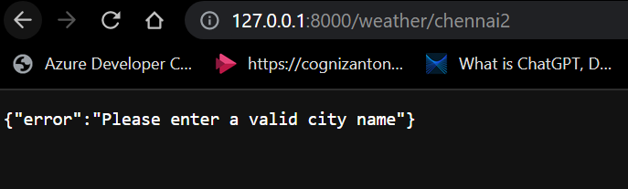
Step 3
I further commands it to check for some conditions before throwing actual response
This can be done by placing a comment within the particular function

Slide 5
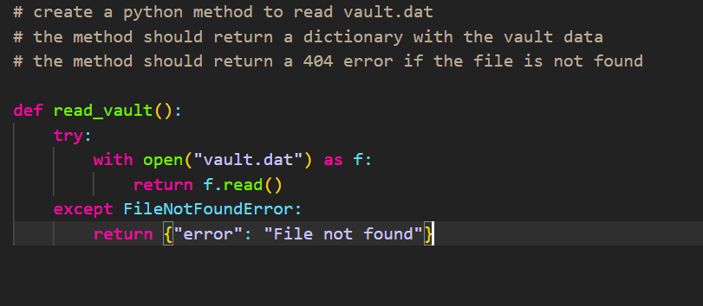
Step 4
Replace Hard Code stuff with an actual API Call
Get API Key and ask CP to write a standalone function to fetch the key.

Slide 6
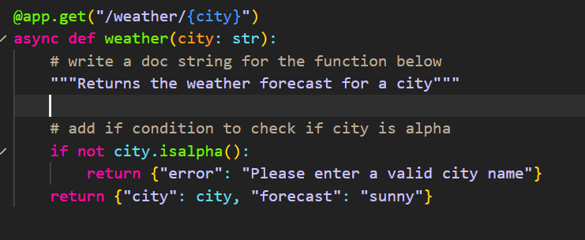
Step 5
It stuck to me that I was not writing any user comments SO I requested for a doc string for all my functions.
It Did Voila!

Slide 7
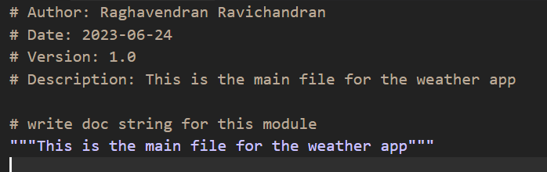
Step 6
Infact I can ask it to write the doc string for entire module.
The moment I navigated to line 1 column 1 ,even before commanding it suggested to provide author,date, version ,etc…
Then It wrote me a doc string for entire module.

Slide 8
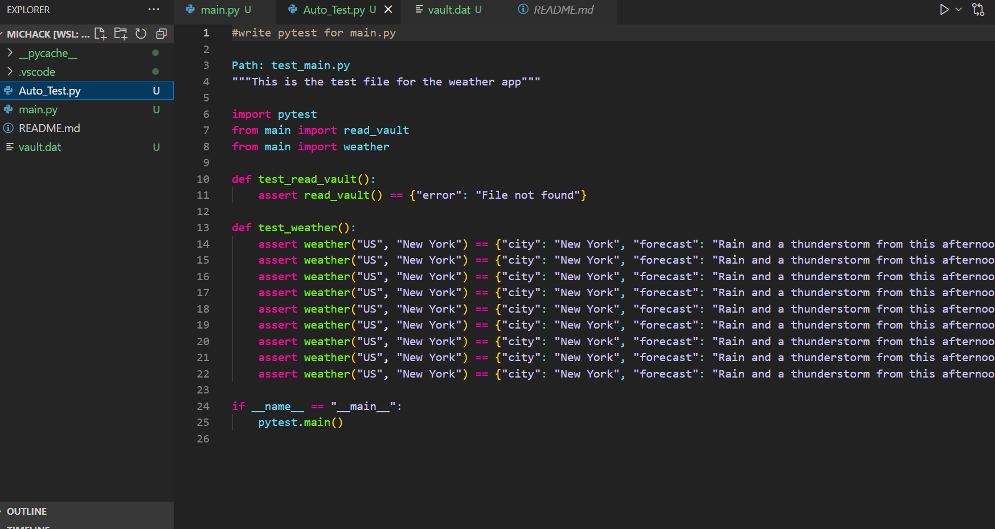
Step 7
Auto generate Pytest module using Co Pilot

Slide 9
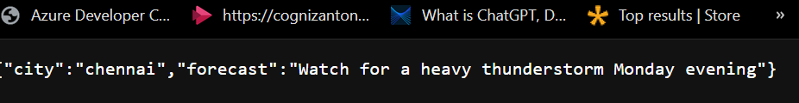
Voila Final Output

Slide 10
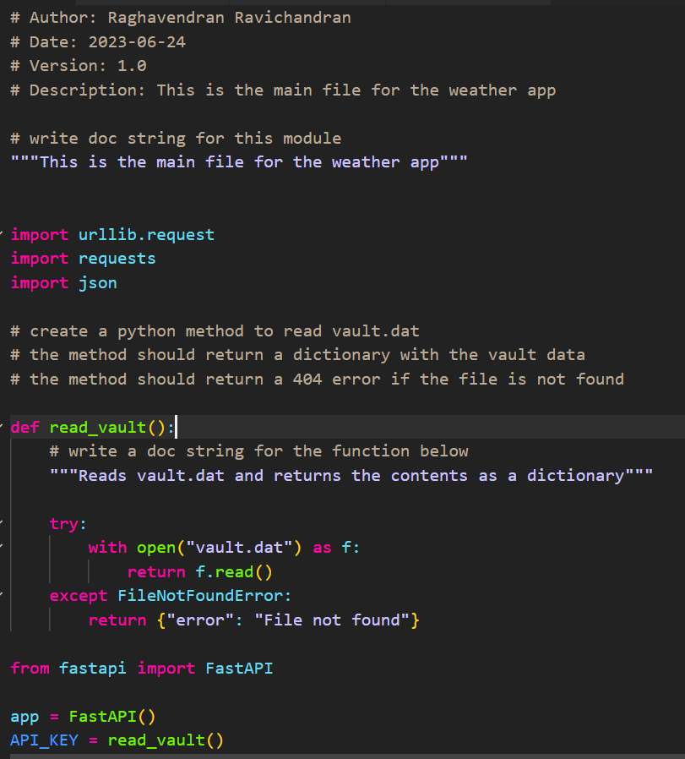
Code Freeze

Slide 11
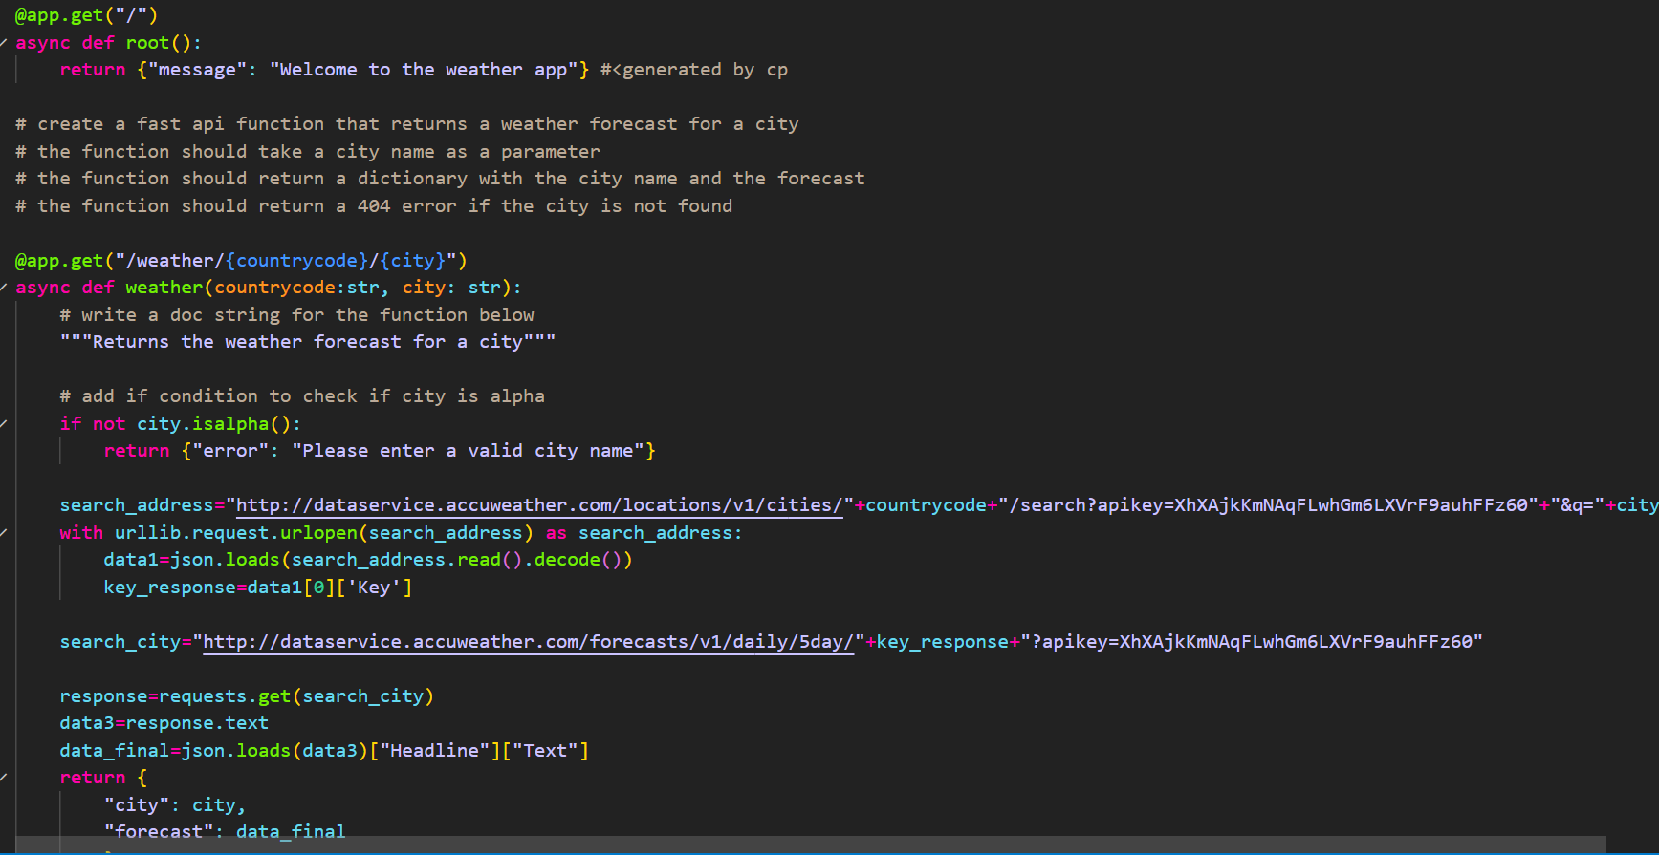

Slide 12
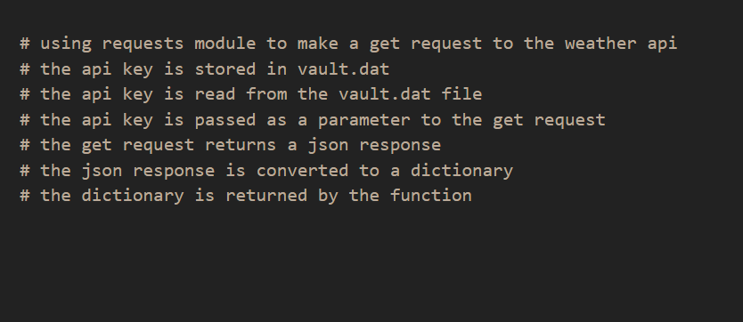

Slide 13
Auto Test

Slide 14
Thanks!

